Slide 1
Design For Excellence

Slide 2
Reference reading material
An Investigation of the Applicability of DfX Tools during Design Concept Evolution - Link
Engineering Excellence
https://www.nngroup.com/articles/

Slide 3
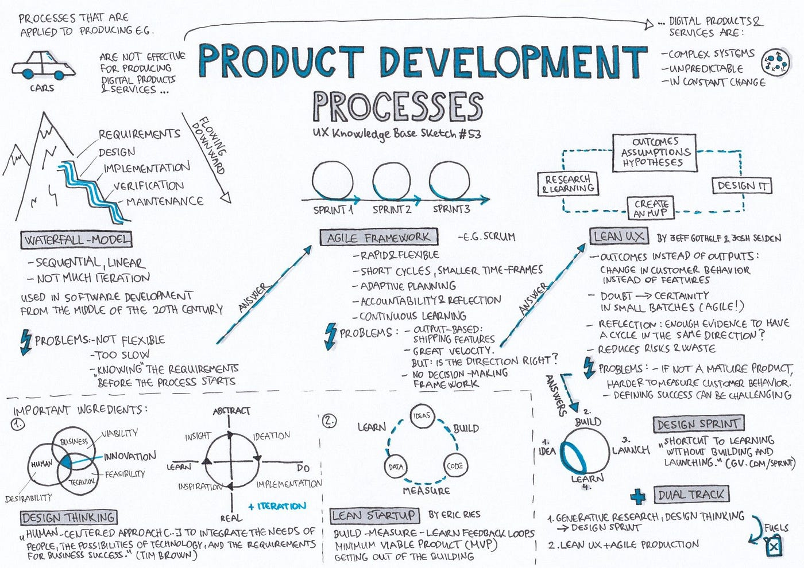

Slide 4
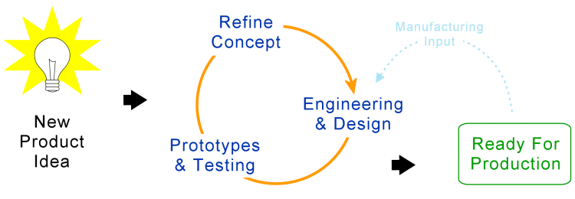
Product Development Process

Slide 5
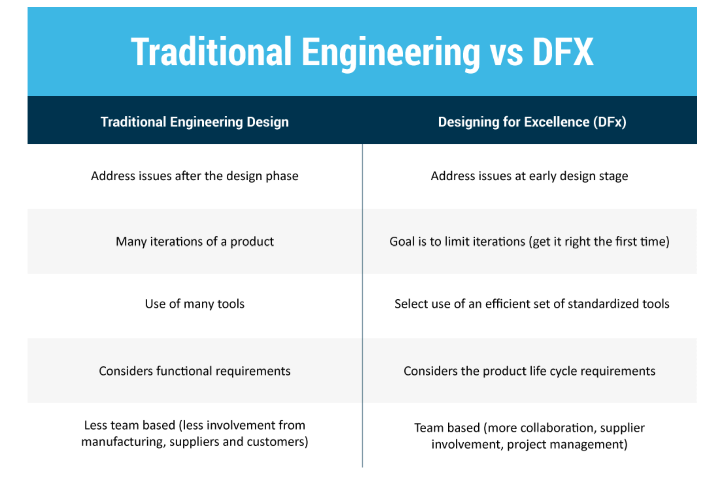

Slide 6
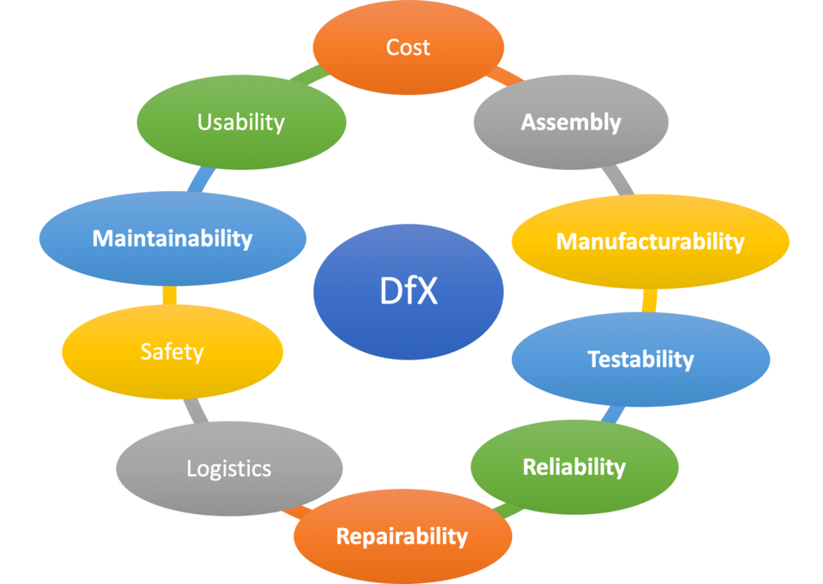
Is DFX , design for Everything?????

Slide 7

Design for Excellence…

Slide 8

Understanding DFX
Design for Excellence (DFX) encompasses various methodologies aimed at optimizing product design.
It focuses on ensuring that products meet all necessary requirements while minimizing costs , maximizing quality and launching faster and...

Slide 9
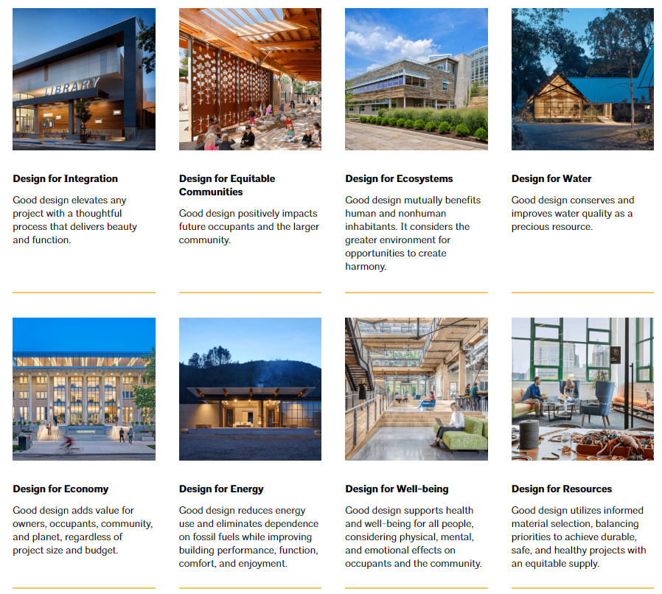
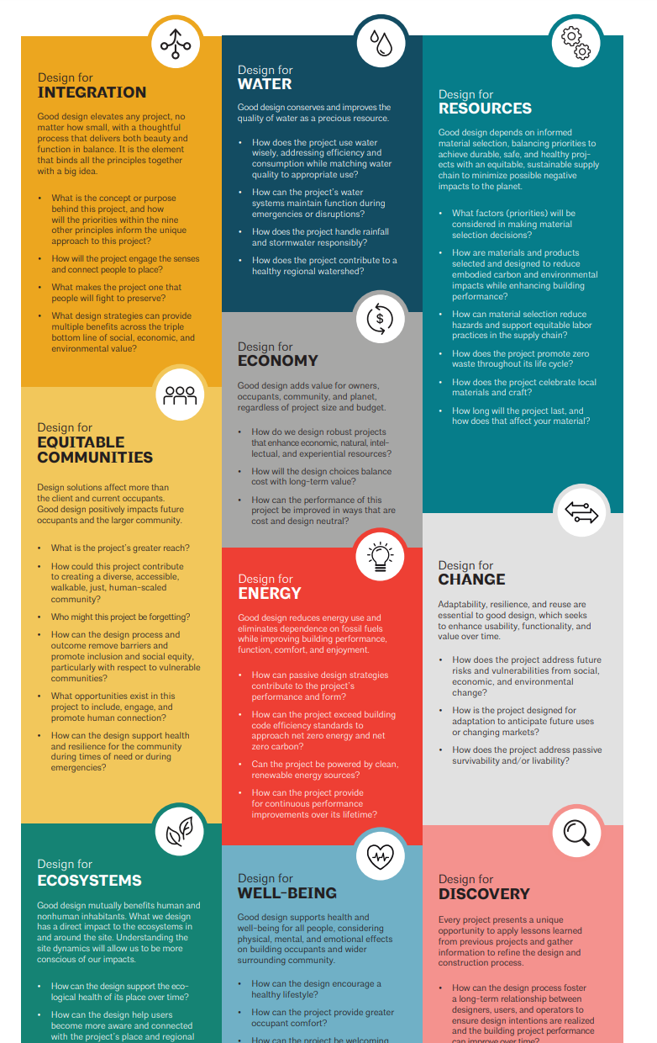
DFX Types -Construction

Slide 10
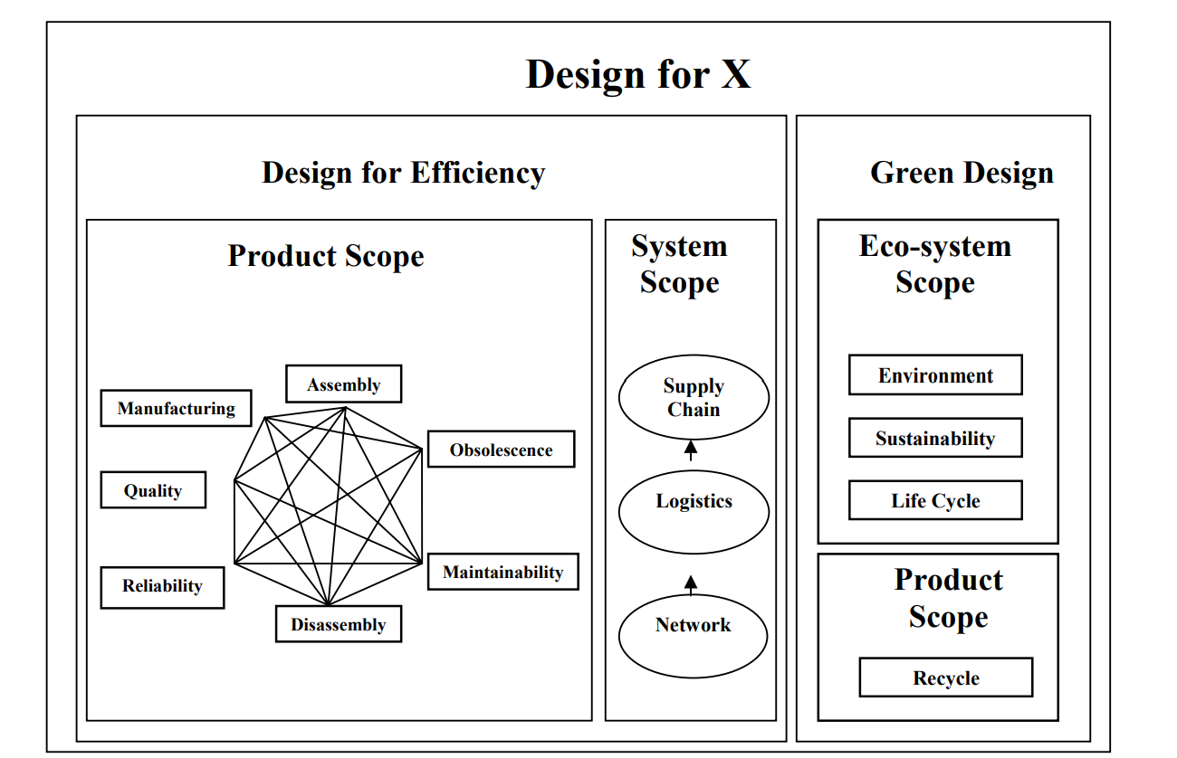
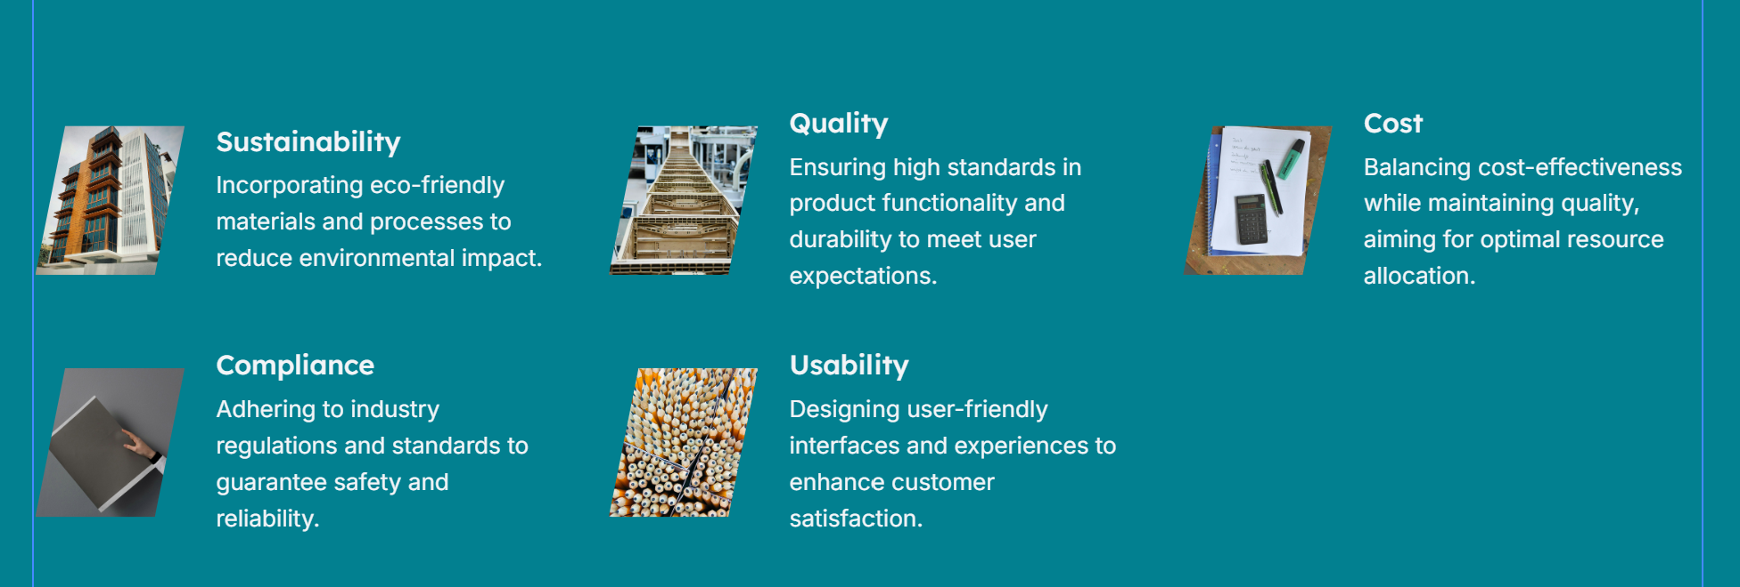
DFX in Product world…

Slide 11
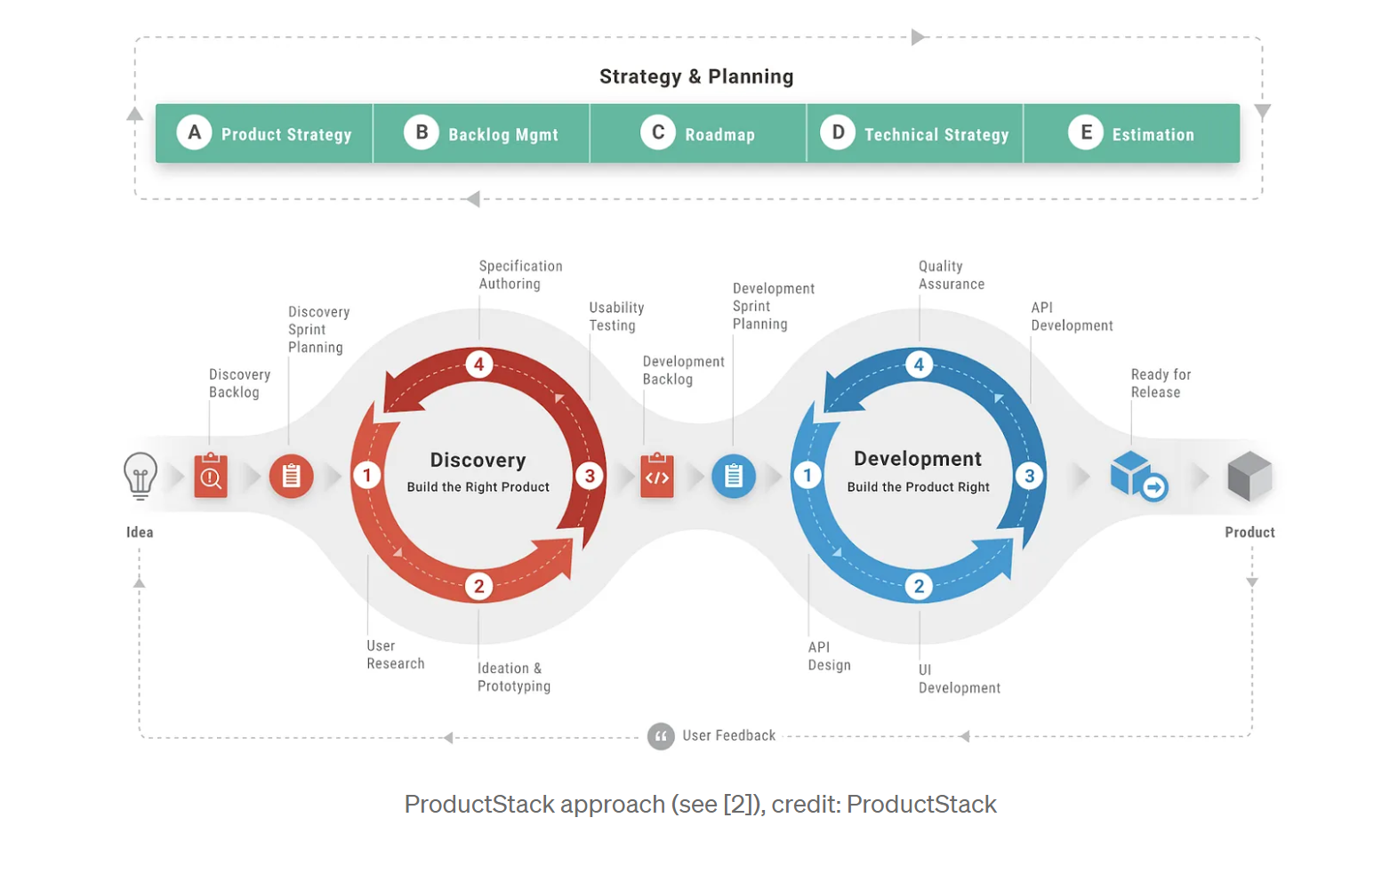
DFX in Digital…
What should be the considerations….

Slide 12
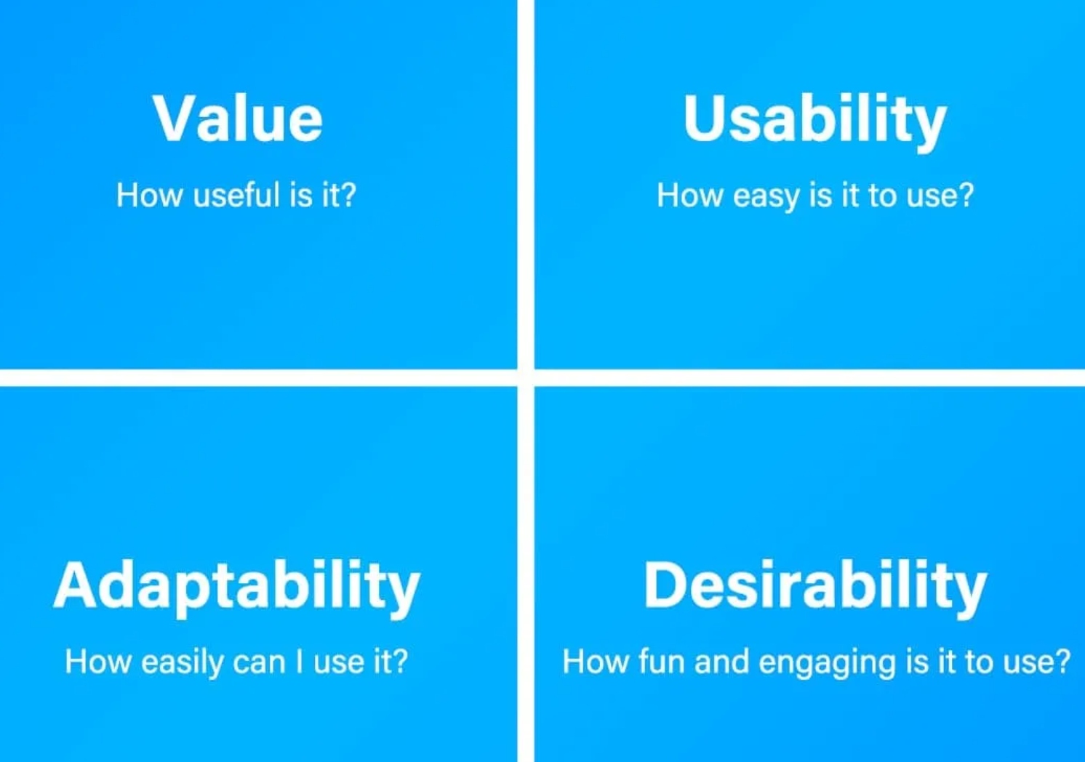


Design for Usability & UX

Slide 13
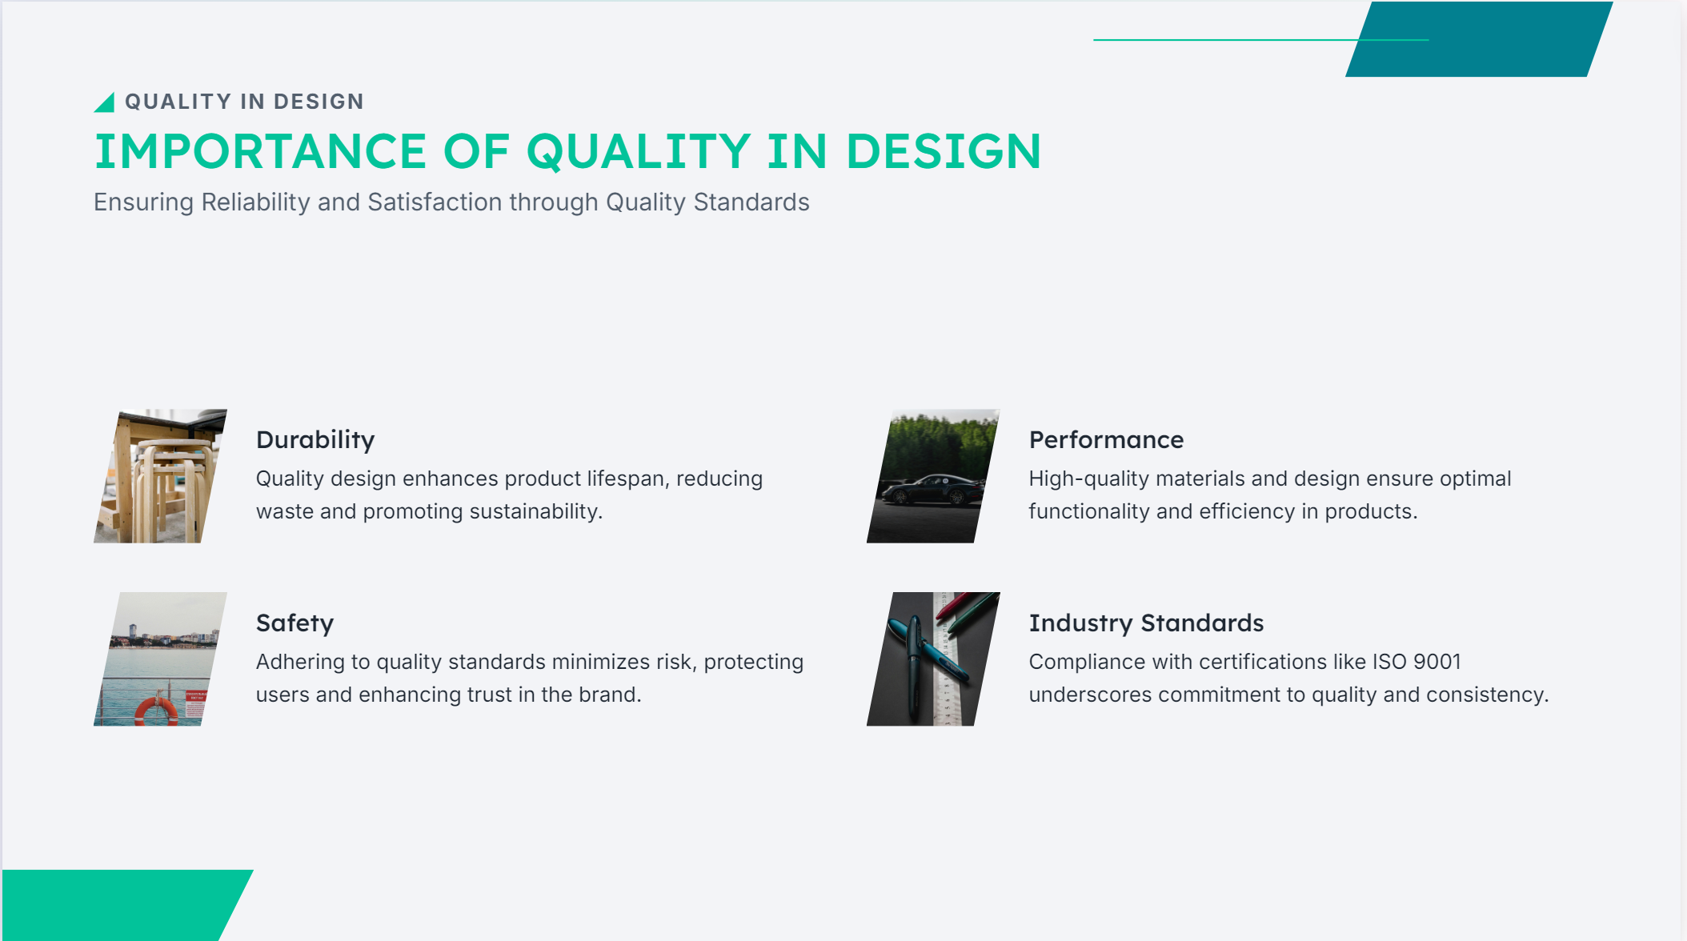

Slide 14
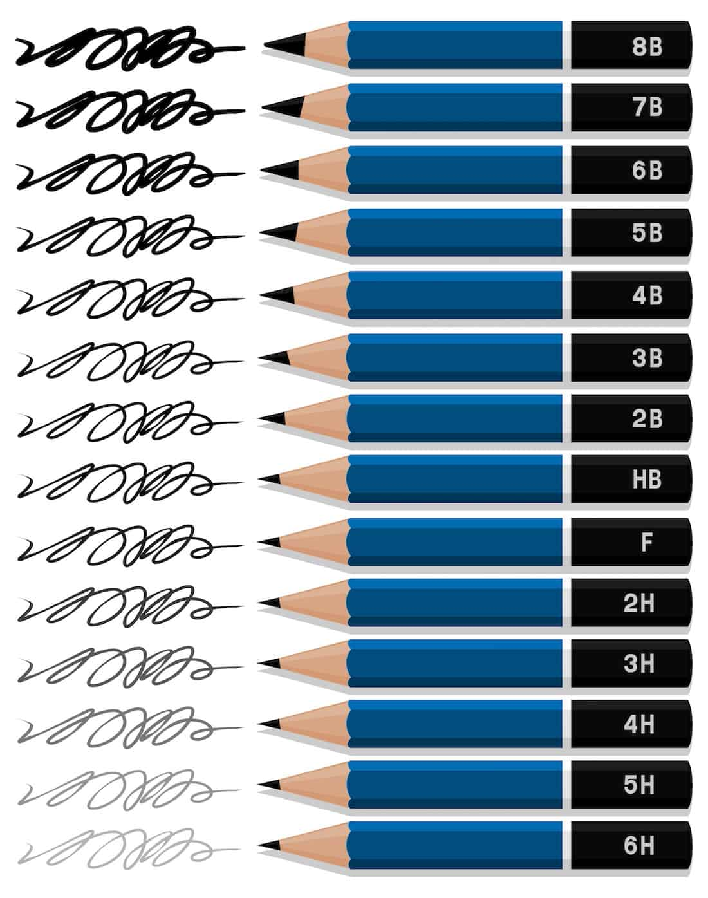
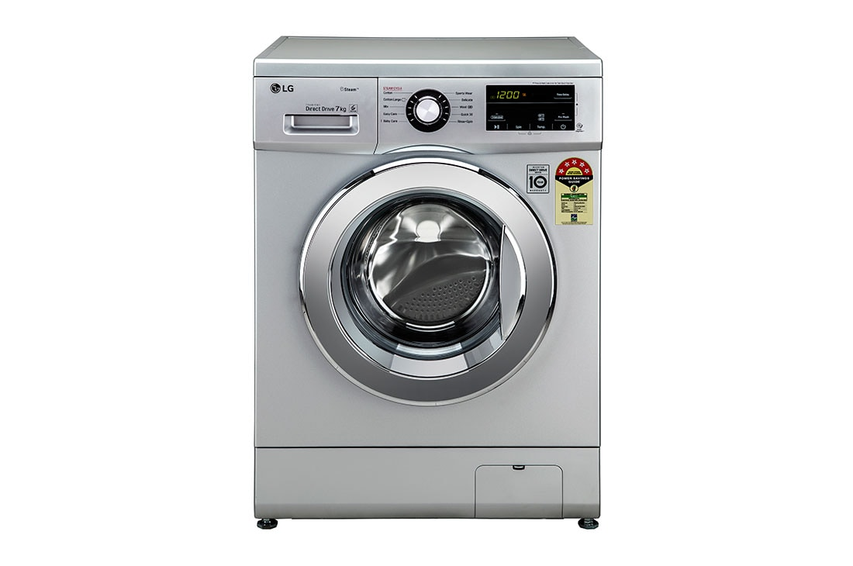

How do we define quality?

Slide 15
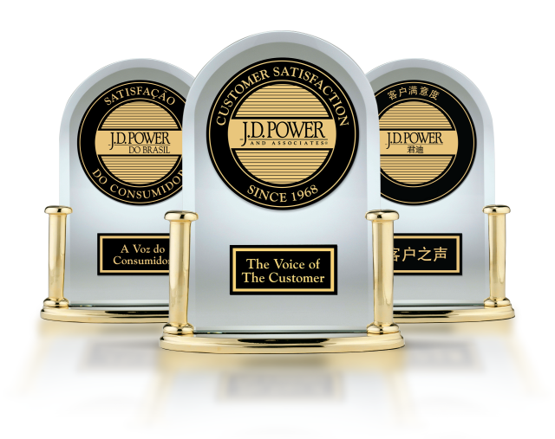

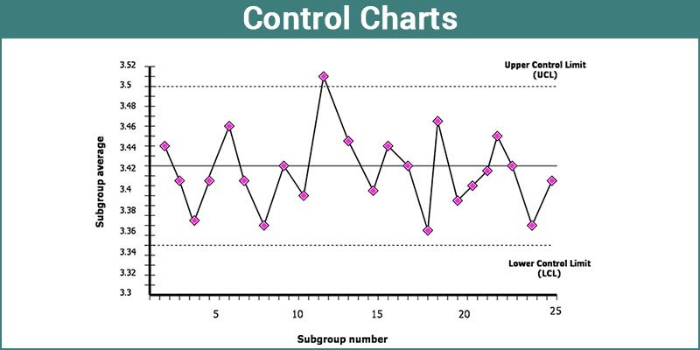
What is Quality?
Product Quality
Process Quality
Service Quality

Slide 16


Slide 17
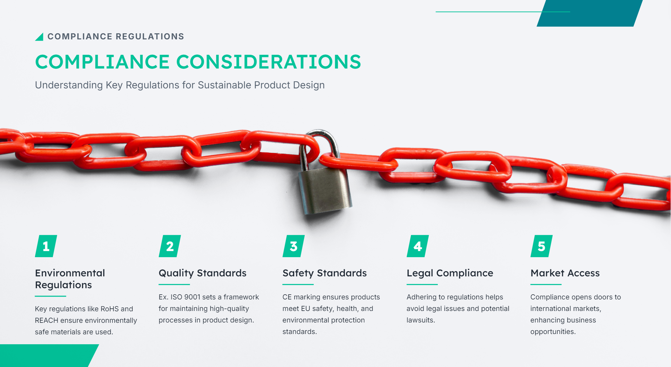

Slide 18

Cost Efﬁciency in DFX
Integrating cost efﬁciency into design means identifying and eliminating unnecessary expenses. By applying DFX principles, organizations can achieve savings through better material selection, streamlined processes, and enhanced productivity, ultimately leading to a stronger bottom line.

Slide 19
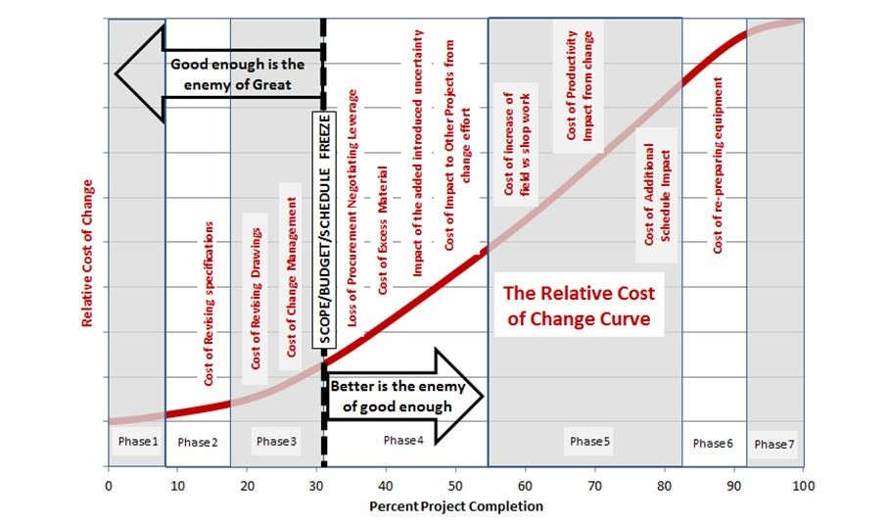
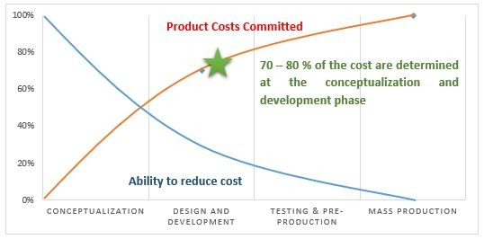
Inverse relation of Design/cost Optimisation

Slide 20
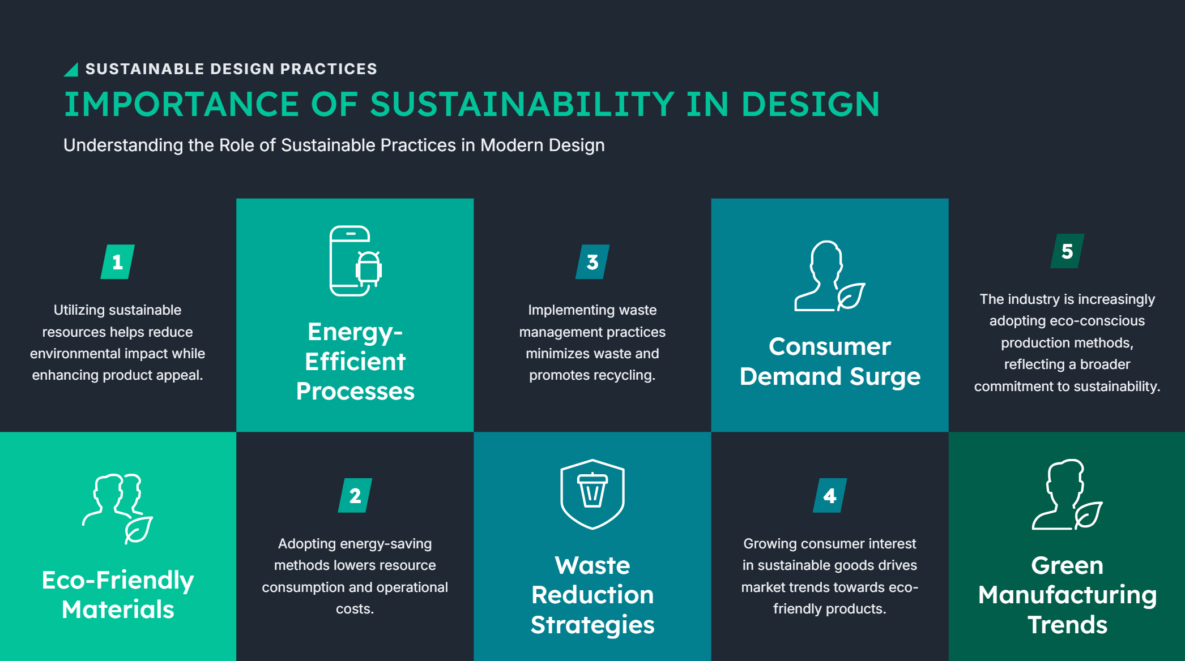

Slide 21
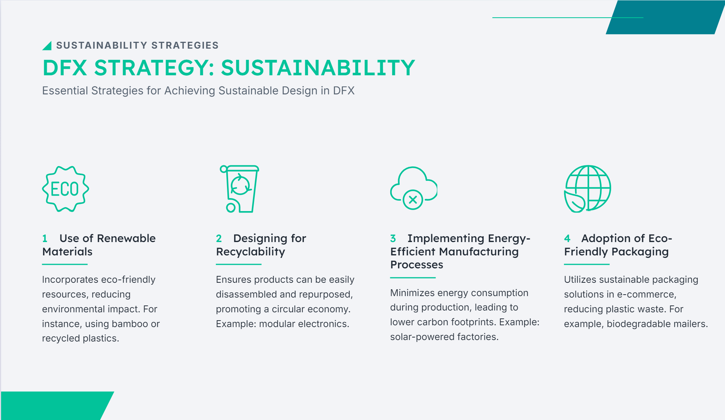

Slide 22


Case Study: Sustainability in Automotive Industry
Exploring Tesla's Sustainable Practices and Their Impact
Notes:
https://www.youtube.com/watch?v=pq8T_UyT00M

Slide 23

Design for Excellence
Craftsmanship
Effectiveness
Productivity
Happiness

Slide 24
Assignment 3: Select the DFx element of interest
Select 1 of the DFX elements of interest
Take the Product example from the previous assignment & apply the DFX Element
Prepare your optimization paper

